Slide 1
Store Books ETL and Data Warehouse Project
Prepared by
Patrice
Alexia

Slide 2
Project Objectives
This project aims to transform the existing Store Books Sales database into a robust data warehouse, enabling advanced analytics and reporting capabilities. The project involves the use of Extract, Transform, Load (ETL) processes to migrate and transform data.
This project involves the use of Microsoft SQL Server as a database type, SQL Server management Studio(SSMS) as a technology stack, Jupyter as python editor and power BI as a reporting tool

Slide 3
Key term
Primary Key (PK): A column (or combination of columns) that uniquely identifies each row in a table.
Foreign Key (FK): A column that creates a relationship between two tables by referencing the primary key of another table.
Business Key (BK/Natural Key): A real-world identifier from source systems that uniquely identifies an entity in business terms. (each primary is a business key but not each business key a primary key)
Surrogate Key (SK): An artificial/system-generated key (usually numeric) used as the primary key in dimension tables.
Database: it is a collection of related data that use OLTP instead of OLAP
Data warehouse: it is a storage of historical data from different sources

Slide 4
Source Database Structure

Slide 5
Data Warehouse Design (Star Schema)

Slide 6
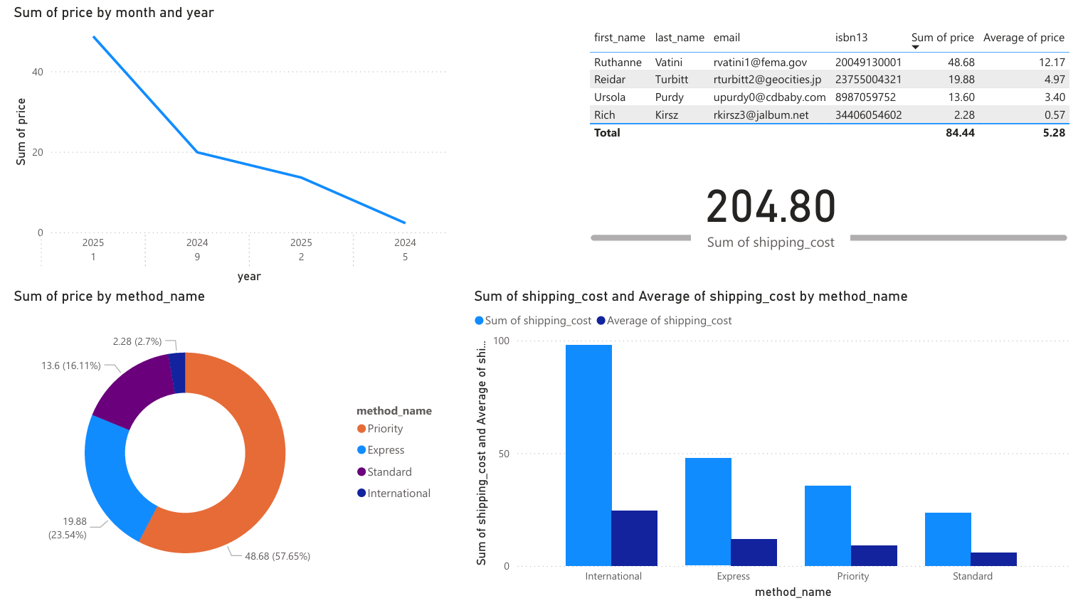
Practical part
1. ETL Pipeline (let jump to jupyter)
2. Analysis Dashboard by using Power BI

Slide 7
Conclusion
This project transformed the Store Books Sales database into a powerful analytics solution by implementing a star schema data warehouse with a central FactOrder table and key dimension tables. Through efficient ETL processes, data was cleansed and optimized for analysis, providing valuable insights via interactive Power BI dashboards.

Slide 8
THANK YOU!

